Slide 1
Office of Analytics Department of Health and Human Services
Steve Sisolak Governor
Richard Whitley, MS Director

Slide 2
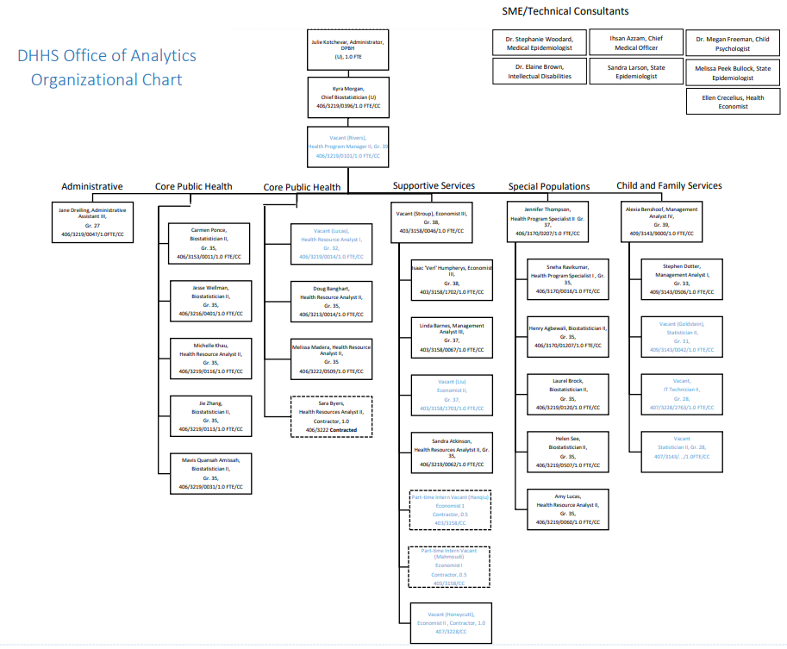
Office of Analytics
Established November 2017
Provide analytical support to all Divisions in DHHS
http://dhhs.nv.gov/Programs/Office_of_Analytics/DHHS_Office_of_Analytics/

Slide 3
Available Data:
AVATAR (adult and children's mental health)
Adult Substance Abuse Treatment Episode Dataset (TEDS)
Behavioral Risk Factor Surveillance System (BRFSS)
Child Welfare Data
Criminal History Repository
DWSS Enrollment
Early Hearing Detection
Health Care Quality and Compliance (HCQC)
HIV, STD, TB, Communicable Disease Cases (NBS/NEDSS)
Hospital Emergency Department Billing (HEDB)
Hospital Inpatient Billing (HIB)
Juvenile Justice Data
Medicaid Decision Support System (DSS)
Medicaid Data Warehouse
Enrollment
Claims
Nevada Central Cancer Registry (NCCR)
Nevada Early Home Visiting
Nevada Population Data (State Demographer)
Immunizations (WebIZ)
Nevada Electronic Birth Registry System
Nevada Electronic Death Registry System
PRAMS
Prescription Drug Monitoring Program
Sentinel Events Registry
Syndromic Surveillance
Women Infants and Children Data (WIC, NVWISH)
Youth Risk Behavior Survey (YRBS)

Slide 4
What can analytics do for you?
Quantify an occurrence.
Describe a specific population.
Compare your data against relative benchmarks:
https://www.healthypeople.gov/2020/topics-objectives
Follow long-term trends and patterns of disease, conditions, services, costs, etc.
Detect sudden changes in occurrence and distribution of diseases, conditions, services, costs, etc.
Identify root causes of changes in patterns of disease, conditions, services, costs, etc.
Direct resources ($ and people)
Initiate policy change

Slide 5
What can analytics do for you?
Help you decide how to present your data:
Total Case Count: number of cases in a population/area in a given amount of time or on a certain date.
Crude Rate: number of new cases in a specified population during a period of time, usually expressed as the number of cases per 100,000 population at risk (normalizes the measure for population density).
Age-Adjusted Rate: calculated by multiplying each crude rate by the weight in that age group of the U.S. standard population, and summing the products (normalizes the measure for population density and age distribution).

Slide 6
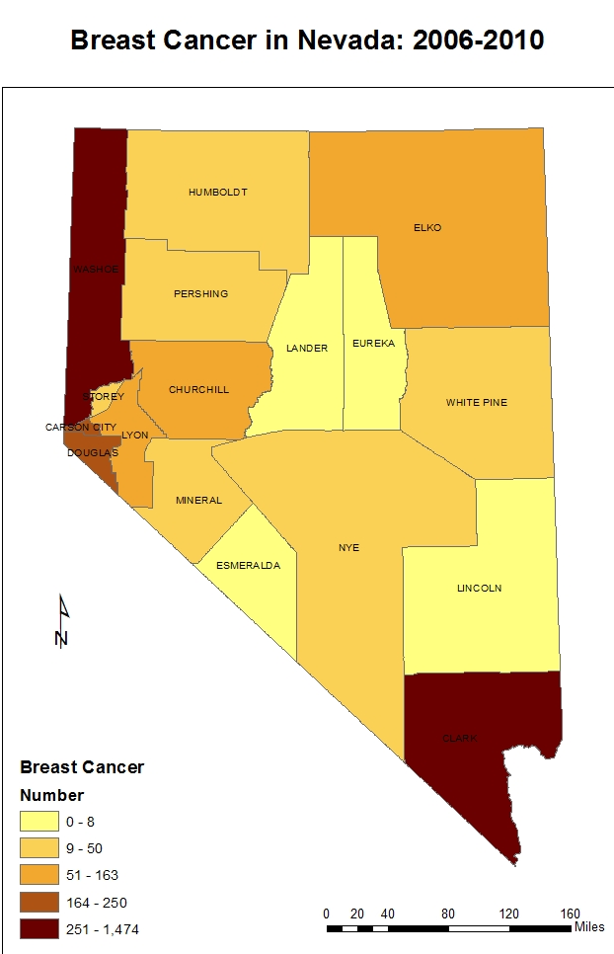
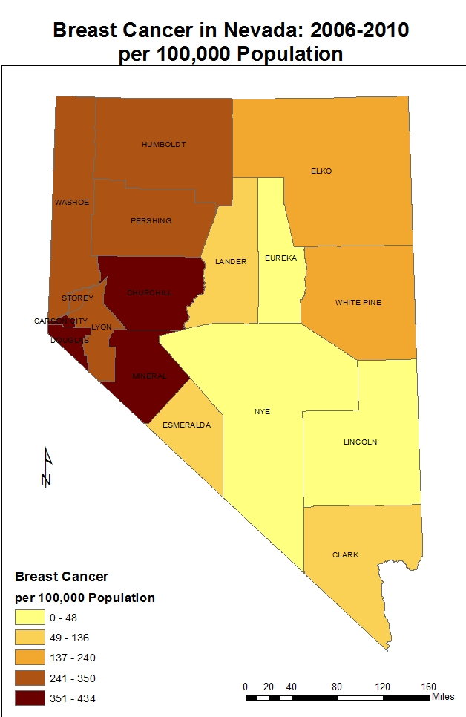
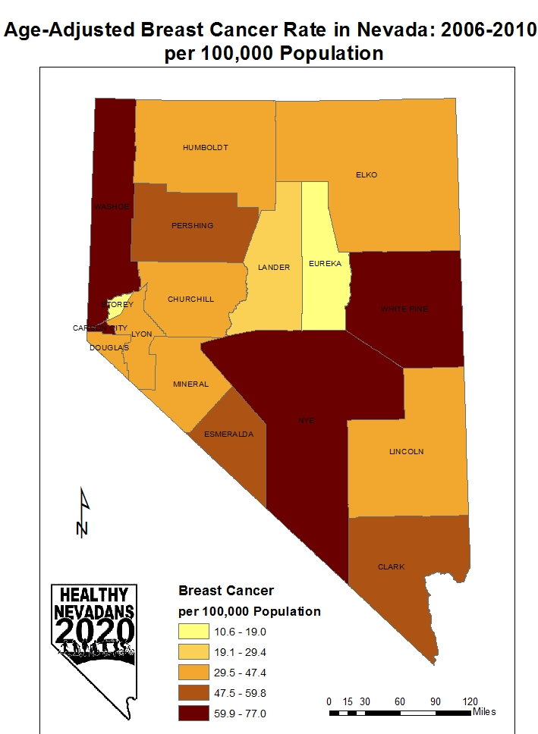
What can analytics do for you?

Slide 7
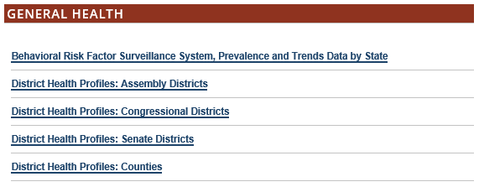
What can analytics do for you?
Who is the population of interest?

Slide 8
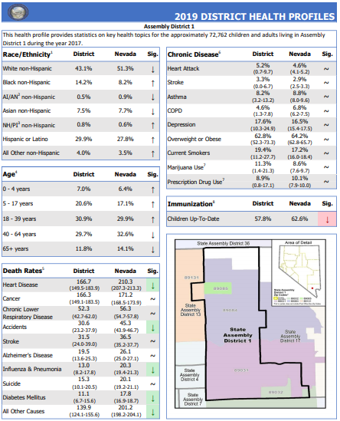
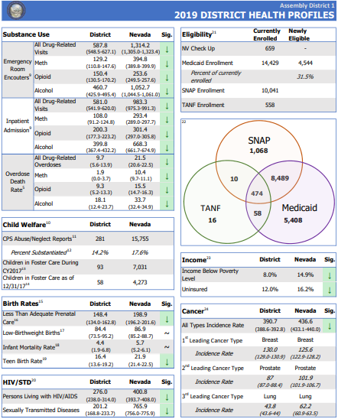
District Health Profiles

Slide 9
Questions and Discussion
Kyra Morgan, MS
State Biostatistician
Office of Analytics
Department of Health and Human Services
kmorgan@health.nv.gov
775-684-4161

